Slide 1

Quantiva Technologies
Follow-on Share Offering:
Seize the Investment Opportunity

Slide 2
Forward-Looking
Statements
Forward-Looking Statements. Statements in this presentation and the accompanying oral presentation that are not statements of historical fact are forward-looking statements. Such forward-looking statements include, without limitation, statements regarding the Company’s future results of operations or financial condition, including guidance for 2025, new shop openings, business strategy and plans, objectives of management for future operations, and potential growth opportunities. Words such as “anticipate,” “believe,” “contemplate,” “continue,” “could,” “estimate,” “expect,” “intend,” “may,” “plan,” “potential,” “predict,” “project,” “should,” “target,” “toward,” “will,” or “would,” or the negative of these words or other similar terms or expressions are intended to identify forward-looking statements, though not all forward-looking statements necessarily contain these identifying words. You should not rely on forward looking statements as predictions of future events. We have based the forward-looking statements primarily on our current expectations and projections about future events and trends that we believe may affect our business, financial condition, and results of operations. The outcome of the events described in these forward-looking statements is subject to risks, uncertainties, and other factors. Moreover, we operate in a very competitive and rapidly changing environment. New risks and uncertainties emerge from time to time, and it is not possible for us to predict all risks and uncertainties that could have an impact on the forward-looking statements. The results, events, and circumstances reflected in the forward-looking statements may not be achieved or occur, and actual results, events or circumstances could differ materially from those described in the forward-looking statements. We undertake no obligation to update any forward-looking statements made in this presentation to reflect events or circumstances after the date of this presentation or to reflect new information, actual results, revised expectations or the occurrence of unanticipated events, except as required by law. We may not actually achieve the plans, intentions or expectations disclosed in our forward-looking statements, and you should not place undue reliance on our forward-looking statements. Our forward-looking statements do not reflect the potential impact of any future acquisitions, mergers, dispositions, joint ventures or investments. Our forward-looking statements are subject to known and unknown risks, uncertainties, assumptions and other important factors, many of which are outside Dutch Bros’ control that could cause actual results to differ materially from the results discussed in the forward-looking statements, including those related to general economic conditions, inflation, increased labor costs, disruptions in our supply chain, ability to hire and retain employees, and other risks, including those described under the heading “Risk Factors” in our Annual Report on Form 10-K for the year ended December 31, 2024 filed with the SEC on February 13 2025, our Quarterly Report on Form 10-Q for the quarter ended March 31, 2025 filed with the SEC on May 8, 2025, and in our future reports to be filed with the SEC, including our Quarterly Report on Form 10-Q for the quarter ended June 30, 2025.
Non-GAAP Measures. The Company prepares and presents its consolidated financial statements in accordance with generally accepted accounting principles in the United States (“GAAP”). However, management believes that certain non-GAAP financial measures, such as Adjusted EBITDA, adjusted net income, and company-operated shop contribution, provide investors with additional useful information in evaluating the Company’s core operating performance. These non-GAAP financial measures, which may be different than similarly titled measures used by other companies, are presented to enhance investors’ overall understanding of our financial performance and should not be considered a substitute for, or superior to, the financial information prepared and presented in accordance with GAAP. We believe that these non-GAAP financial measures provide useful information about our financial performance, enhance the overall understanding of our past performance and future prospects and allow for greater transparency with respect to important measures used by our management for financial and operational decision making. We are presenting these non-GAAP financial measures to assist investors in seeing our financial performance using a management view and because, in some cases, we believe that these measures provide an additional tool for investors to use in comparing our core financial performance over multiple periods with other companies in our industry. We urge you to review the reconciliation of our non-GAAP financial measures to the most directly comparable GAAP financial measures set forth in the slides and Appendix to this presentation, and not to rely on any single financial measure to evaluate our business.
Market and Industry Data. This presentation contains estimates and information concerning our industry, including market position and the size and growth rates of the markets in which we participate, that are based on industry publications and reports and other information from our internal sources. This information involves a number of assumptions and limitations, and you are cautioned not to give undue weight to these estimates. We have not independently verified the accuracy or completeness of the data contained in these industry publications and reports. The industry in which we operate is subject to a high degree of uncertainty and risk.

Slide 3

Who We Are
Quantiva (NASDAQ: QNTA) was founded on a simple belief:
Investment professionals deserve modern technology that actually works for them. Not legacy systems that slow them down. Not fragmented data that creates confusion. But one comprehensive platform that gives you complete visibility and crystal-clear insights.
The result?
Investment management that works as seamlessly as your investment strategy.
Since our founding in 2004,
Quantiva has been the trusted technology partner powering the world’s leading institutional investors — from insurance companies, asset managers, and hedge funds to asset owners like corporations, endowments, and pension funds managing over $10 trillion in assets.

Slide 4
Quantiva Solutions
Investment Accounting and Reporting
Multi-Asset Class; Multi-Currency
Operational and Regulatory Accounting
Performance Measurement
GIPS Compliant Composites
Custom Benchmarks
Multi-Level Portfolio Performance Reporting
Compliance Monitoring
Investment Guideline Coding
Pre- and Post-Trade Compliance Checks
Risk Analytics
Powerful risk exposure reporting
Scenario Analysis, VaR, risk factor contributions

Slide 5

Share Offering Overview
40,000,000
Total Shares Offered
$15.37
Offering Price
8.7%
Increase in Shares Outstanding
Q4 2025
Anticipated Offering Timeline

Slide 6
Investment Opportunity
Expanding our competitive advantages through cutting edge technology and AI
  Winner take most competitive landscape
  Differentiated by market-leading platform capabilities
  Innovation insights driven by client-identified needs
  Significant growth potential via growing addressable market and market share gains
  Resilient SaaS model with recurring revenue streams
  Platform is mission-critical to client operations
  98% Annual Retention Rate

Slide 7

Use of Proceeds
Strategic allocation of funds for critical growth initiatives
  Technology infrastructure investments
  Data center capacity expansion
  Technology feature enhancements

Slide 8

Quantiva
Technologies
Financial Highlights
Key Fact: Our average client retention rate by revenue is 98%

Slide 9
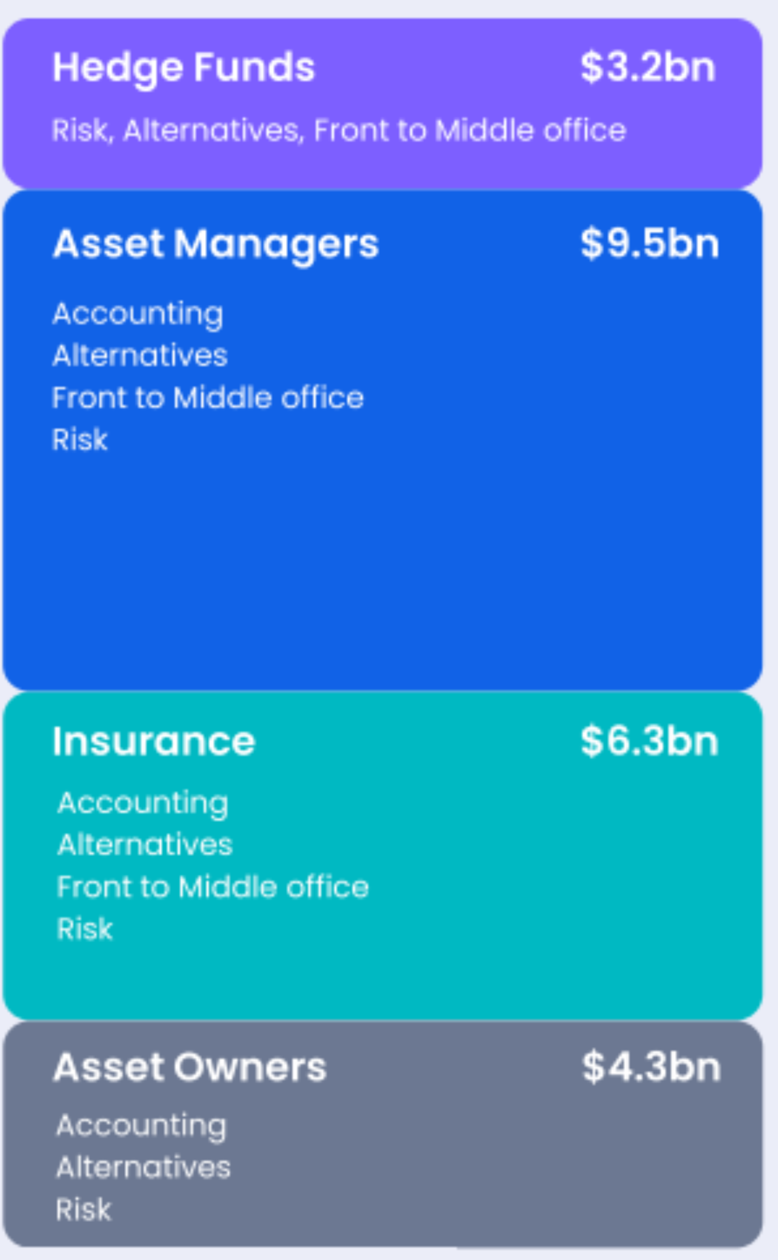
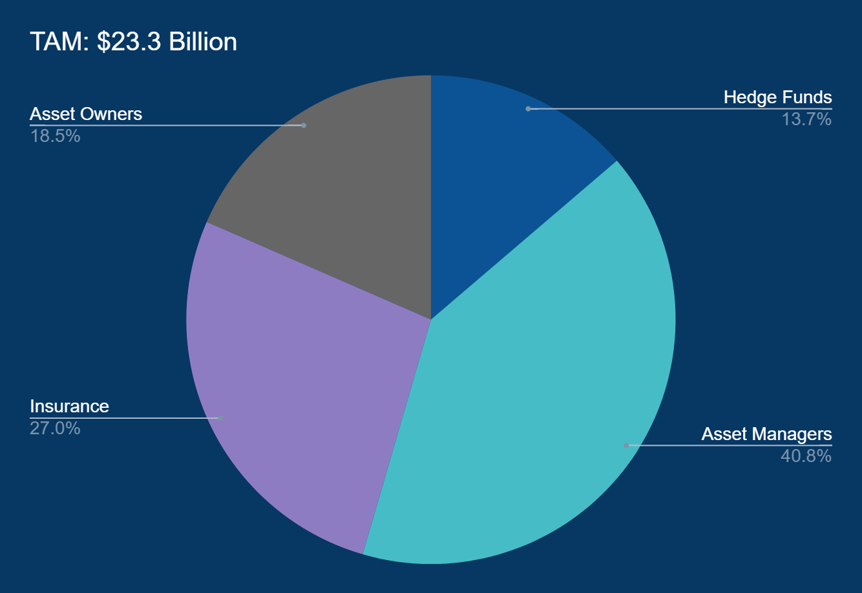
TAM:
$23.3 Billion

Slide 10
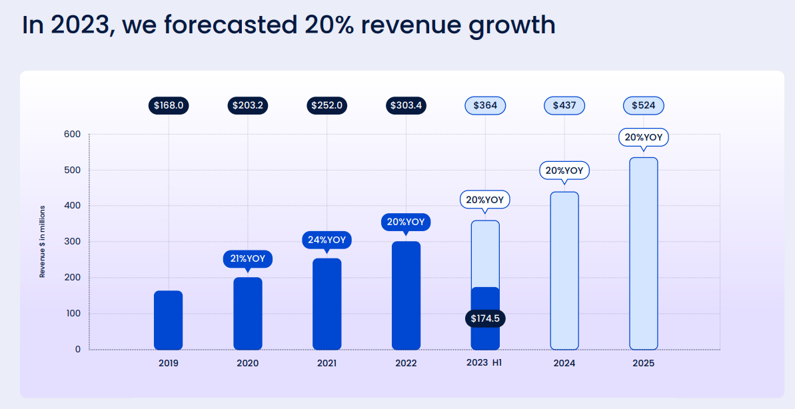

Slide 11
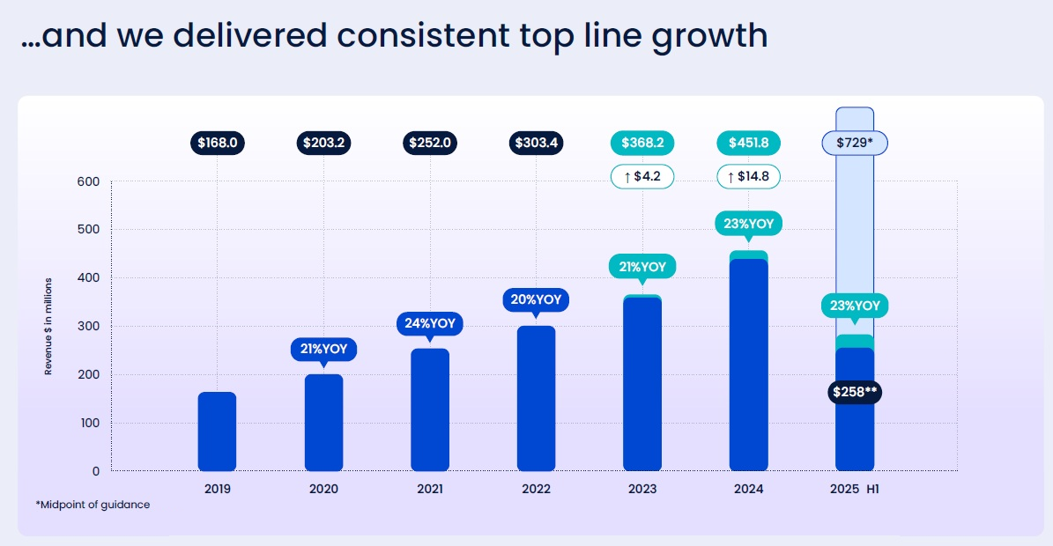

Slide 12
Margin Analysis
 | 2023 (A) | 2024 (A) | 2025 (A) | 2026 (F) | 2027 (F) | 2028 (F)
Gross Margin | 71% | 73% | 66% | 67% | 67% | 67%
EBITDA Margin | -4% | -4% | 12% | 1% | 20% | 32%

Slide 13
Valuation
    Offering Price: $15.37
    14.7% discount from 9/30/2025 closing price ($18.02)
    55x 2025 EBITDA forecast
    21x 2027 EBITDA forecast

Slide 14
Dilution Effect / EPS Sensitivity
SHARE COUNT ANALYSIS | Shares
Shares Outstanding Q3 (000s) | 288,154
Primary Shares Issued (000s) | 25,000
Shares Outstanding After Offering (000s) | 313,154
BASIC EPS CALCULATION 2027 Forecast
 | Before Offering | After Offering
Shares Outstanding (000s) | 288,154 | 313,154
Net Income ($000s) | 114,800 | 114,800
Basic EPS | $0.3984 | $0.3666

Slide 15




Meet the Leadership Team
Elena Vargas
Marcus Lee
Sophia Patel
Jordan Hale
CEO & Executive Chairwoman of the Board
Chief Financial Officer
Chief Operating Officer
Chief Revenue Officer

Slide 16
Our vision for the future remains the same
Be the world’s most trusted and comprehensive technology platform that simplifies the entire investment lifecycle...
and eventually revolutionize the world of investing.

Slide 17

Conclusion
Next steps for participation and engagement in QNTA's growth
Email
info@quantiva.com
Phone Number
(650) 555-0001
Website URL
www.quantiva.com

